Slide 1
Data Engineering
Apache Spark Framework

Slide 2

Module Objectives
After completing this course you will be able to:
Define what Spark is
Understand Spark’s architecture
List Spark’s supported languages
List Spark’s high-level libraries
Explain Spark’s execution model
Compare Spark and Hadoop at a high level

Slide 3
Apache Spark: Definition
What is Spark?
Apache Spark is a unified engine
designed for large-scale distributed data processing,
on premises in data centers or in the cloud.
Its processing model derives from MapReduce, with one new key feature:
In-memory storage of intermediate results
this new feature gave it a big edge in performance
it was possible due to technological advancements
There are a few more differences that we shall leave aside for now

Slide 4
Apache Spark: Architecture
Compared to MapReduce, Spark does a lot more than just processing. The Spark Stack includes:
Computation Engine
It processes big data in a distributed fashion
It can manage jobs and resources independently of the hosting platform
It supports a variety of programming languages
It incorporates libraries with composable API’s for a variety of use cases
Cluster Manager
Language Support
High-Level Libraries

Slide 5
Apache Spark: Storage
Spark’s scope is not quite as broad as Hadoop’s though
it lacks the storage layer
this actually makes Spark more versatile and appealing
Spark can connect to:

Slide 6
Apache Spark: Language Support
Spark operations can be expressed in any of the supported languages
As of 2020, Spark supports five languages:
S c a l a
J a v a
P y t h o n
S Q L
R

Slide 7
Apache Spark: Unified Analytics
Spark also includes a unified system of high-level libraries
Spark SQL - query structured data from flat files or RDBMS
Spark Streaming - react in real-time to data from many streaming sources
MLLib - build and apply machine learning models
GraphX - perform parallel computations on graphs
The system combines a diverse set of workloads under one engine
Previously, batch, stream, graph and query processing could only be
done on separate engines (Storm, Impala, Dremel, Pregel, etc…)
Notes:
Storm, Impala, Dremel and Pregel are, like Spark, distributed computation frameworks. But their scope is more limited than Spark’s. Apache Storm is a stream processing framework. Apache Impala is a Massively Parallel Processing (MPP) SQL query engine. Dremel is the query engine behind Google’s BigQuery. Pregel is another Google system, it is designed to optimize performance on graph algorithms.

Slide 8
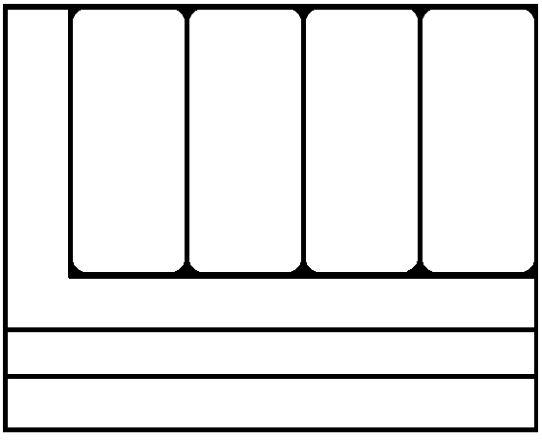
Apache Spark: The Full Stack
To recap, the Spark Stack can be visualized as follows:
Scala
Java
Python
R
SQL
MLlib
SPARK SQL
SPARK Streaming
GraphX
Spark Core and Spark SQL Engine
Resource Management
Computation Engine
Next, we are going to see how these components work together

Slide 9
Apache Spark: Distributed Execution
A Spark application includes a driver program called the Spark driver
the Spark driver maps Spark operations into parallel tasks and schedules their execution
The Spark driver communicate with cluster components through the SparkSession
the SparkSession offers a single unified entry point to all of Spark’s functionality
the cluster components include the cluster manager and the Spark executors
The cluster manager allocates and manages resources for the cluster
supported cluster managers (2020): built-in, Mesos, Yarn, Kubernetes
Spark executors run tasks on the worker nodes
each executor runs on one worker node
in most deployments, each worker node hosts one executor
Notes:
Since Spark 2.0, the SparkSession provides unified access to all Spark operations and data, subsuming previous entry points to Spark like the SparkContext, SQLContext, HiveContext, SparkConf, and StreamingContext. Those other entry points are still available for legacy reasons.
Apache Mesos is an open-source cluster manager created by the same team who invented Spark.
Kubernetes is an open-source container orchestration system for automating application deployment, management and scaling.

Slide 10
Apache Spark: Distributed Execution
The key components of Spark’s distributed execution:
Notes:
NOTE: While each Spark executor runs on a single worker node, an executor can potentially take advantage of multiple executor cores. This enables a single executor to run multiple tasks at the same time (each core running one task at a time).

Slide 11
Apache Spark: Deployment Modes
Spark can be deployed on a wide-range of environments, with varying configurations
For example, when running on Hadoop:
Spark’s built-in cluster manager can be used to manage Spark jobs, or
Yarn can be used to manage a more varied workload
this includes Spark jobs as well as other jobs
the parallel features of Yarn negate the need for dedicated Spark clusters
potential is gained via efficient use of the cluster
In distributed mode, the data is partitioned and distributed across the nodes

Slide 12
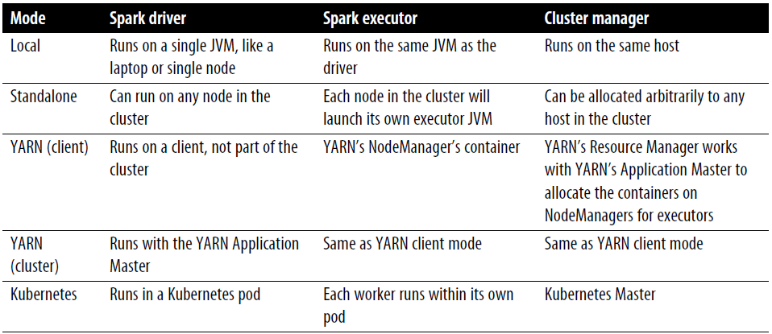
Apache Spark: Deployment Modes
This diagram summarizes the configurations associated to the most common deployment modes:

Slide 13
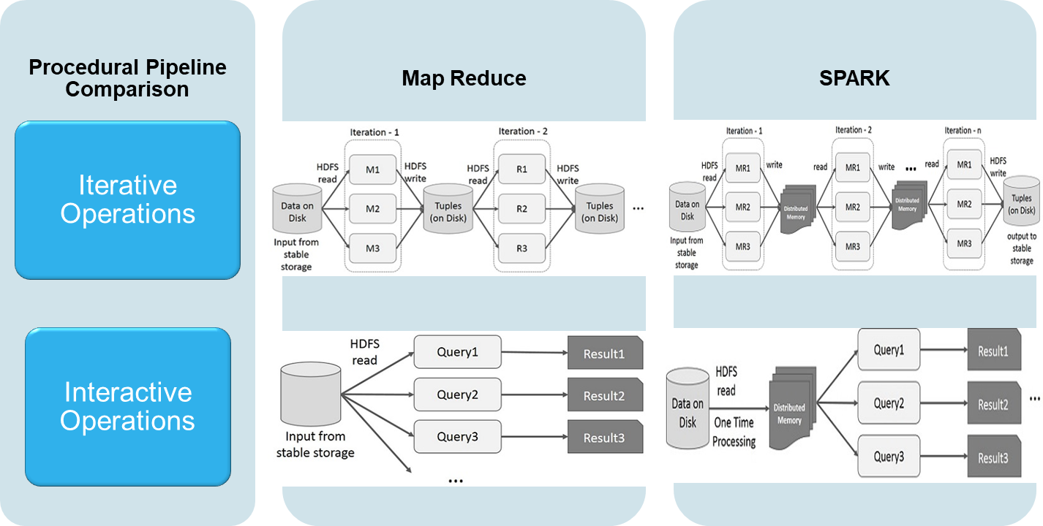
Spark vs Hadoop
The diagram below compares Spark and Hadoop on two kinds of operations:
Interactive operations (using a shell for exploratory data analysis)
Iterative operations (running complex applications, possibly over a distributed cluster)
Later, we will delve deeper into Spark’s execution model
Notes:
MapReduce iterative Operations
Reuse intermediate results across multiple computations in multi-stage applications.
This incurs substantial overheads due to data replication, disk I/O, and serialization, which makes the system slow.
MapReduce interactive Operations (e.g. running hive queries from the shell)
User runs ad-hoc queries on the same subset of data.
Each query will do the disk I/O on the stable storage, which can dominates application execution time.
Spark iterative Operations
Intermediate results are stored in distributed memory instead of stable storage (disk) for faster access.
If the distributed memory (RAM) is not sufficient to store intermediate results, then it will store those results on the disk.
Spark interactive Operations
The result of a query can be kept in memory and used by the next query (using the cache() function).
There is also support for persisting data on disk, or replicating it across multiple nodes (we shall cover these features in the next slide decks).
NOTE: Interactive operations in Spark are currently available in the following shell environments: spark-shell (using Scala syntax); pyspark (using Python); sparkR (using R); spark-sql (using SQL).

Slide 14
Module Review
What components does the Spark architecture contain?
What languages does Spark support?
What is a SparkSession?
What does a Spark executor do?
What deployment modes does Spark offer?
How does Spark’s execution model differ from Hadoop’s

Slide 15
Questions
Notes:
Source:
Learning Spark, 2nd Edition
by Jules S. Damji, Brooke Wenig, Tathagata Das, Denny Lee
Released July 2020
Publisher(s): O'Reilly Media, Inc.

